Slide 1




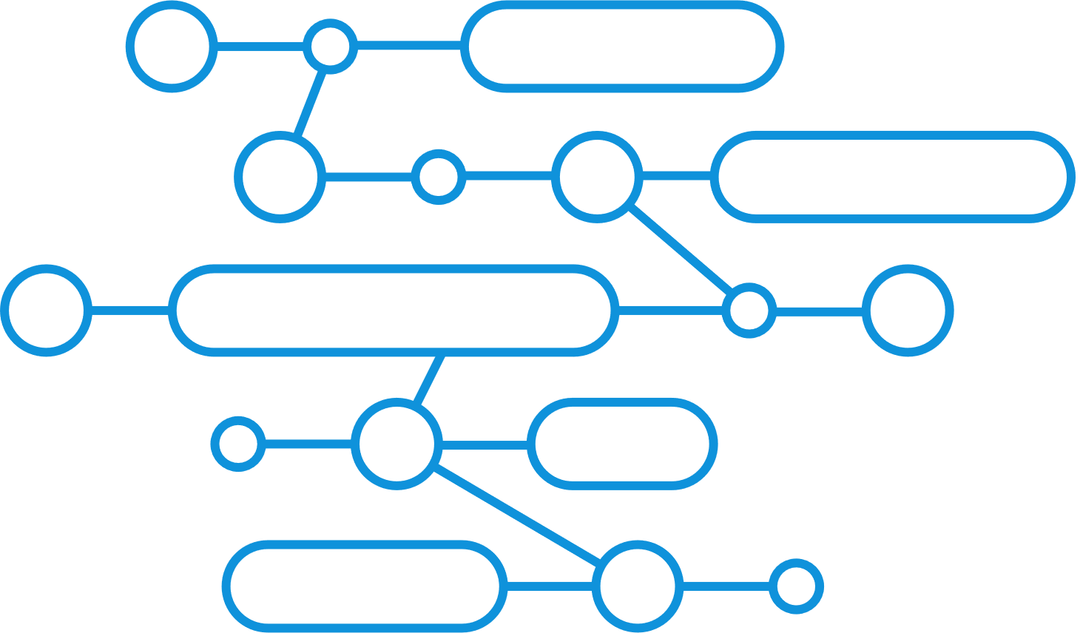
Bestlink College of the Philippines-Bulacan Inc.
HUMAN RESOURCES TALENT MANAGEMENT SYSTEM IN BCP
HR System

Slide 2

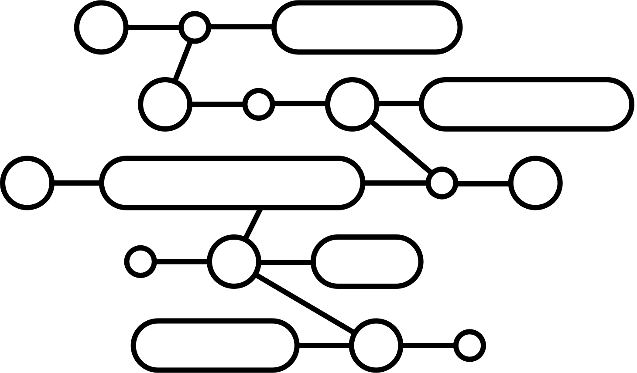
What are the Importance of HR Talent Management System?

Slide 3

An effective HR Talent Management System (TMS) holds significant importance for organizations seeking to attract, develop, and retain top talent in today’s competitive landscape.
Moreover, a TMS is a vital component of an organization’s HR strategy. It not only streamlines recruitment and enhances onboarding but also supports continuous employee development, fostering a culture of growth. By enabling clear performance management through regular feedback and accountability, a TMS facilitates succession planning to prepare future leaders.

Slide 4
Client Background
HUMAN RESOUCES OF BESTLINK COLLEGE OF THE PHILIPPINES
Client Problem:
MISCOMMUNICATION: Poor communication regarding hiring processes and misunderstandings about employee responsibilities and expectations.
MANUAL PROCESSES: Absence of automated systems for streamlined operations and reliance on manual procedures that lead to inefficiencies and errors.
DATA REDUNDANCY: Duplicate or redundant records may be created due to manual processes, leading to inconsistencies and potential confusion.

Slide 5
Solution:
CREATING A HUMAN RESOURCES TALENT MANAGEMENT SYSTEM
Addressing Miscommunication: - Create Detailed Job Descriptions: In job postings, ensure all roles have comprehensive job descriptions that outline responsibilities and expectation. - Real-Time Updates: Implement a notification system for updates on hiring processes and changes in employee roles. This can be through emails or dashboard alerts - Utilize Applicant Tracking Systems (ATS): Implement ATS to streamline the recruitment process and minimize manual tasks.
Streamlining Manual Processes: - Self-Service Portals: Allow employees to manage their profiles, submit requests, and access documents without manual intervention. - Automated Workflows: Develop automated processes for recruitment, onboarding, and performance management. Use forms and templates that can be filled out online.
Data Redundancy - Data Validation Checks: Implement validation rules to prevent duplicate records during data entry. For instance, check for existing email addresses or IDs

Slide 6



STACKS

Slide 7
Project Objectives:
Identify and attract top talent: Ensuring the organization has a pipeline of skilled individuals by actively seeking out and recruiting the best candidates.
Ensure the data accuracy and completeness: The system should ensure that all required information is collected during application, reducing errors and incomplete requirements.
- Student registration: Enable parents or guardians to register their children and provide necessary documentation.
- Grading and Academic Records: Maintain comprehensive academic records for each student, including transcripts and report cards.
- Integration with Existing Systems: Ensure compatibility and integration with other school management systems, such as enrollment, head dean, library, clinic, and guidance systems.

Slide 8
Project Scope:
- Master List of Student: The system has a list or record containing the names and other relevant information of students enrolled in a particular course.
- Certificate of Registration: The system will streamline the admission and enrollment processes, including application management, document submission, and enrollment confirmations.
- Certificate of Grades: The system will provide a centralized platform for recording and managing student grades, calculating GPAs, and generating transcripts.
- Transcript of Records: The system will calculate and manage all student grades, generate transcripts, and record academic achievements from the start of the student registered in a course.
- Student Progress Report: The system will provide reporting capabilities for administrators, teachers, and parents to track student progress, attendance, and other key metrics.
- Viewing of Grades: The system will let the admin to view the student grades if there is a changes or problem.

Slide 9
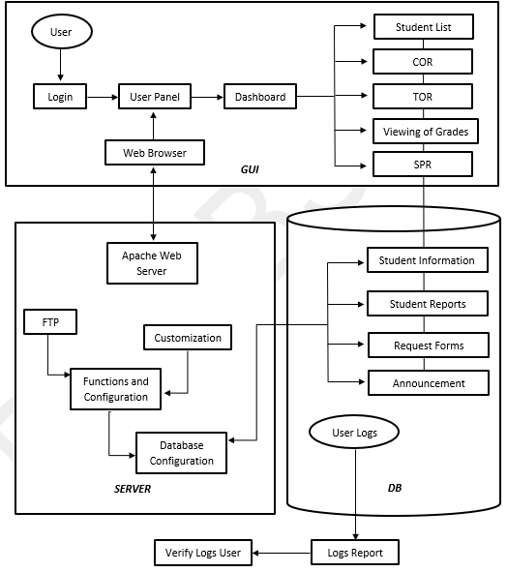
System Architecture

Slide 10
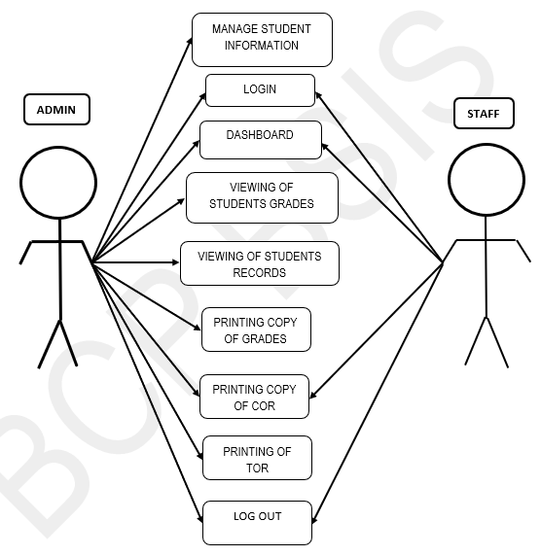
Application Architecture

Slide 11
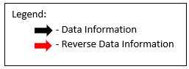
Business Process Architecture
Registrar System Scope
Student List
Certificate of Registration
Certificate of Grades
Transcript of Records
Student Progress Report
Evaluation of Grades
Diploma
Honorable Dismissal
Enrollment Report
Viewing of Grades
Data Information
Reverse Data Information
Data Information
Enrollment
Head Dean
Guidance
Clinic
Library

Slide 12
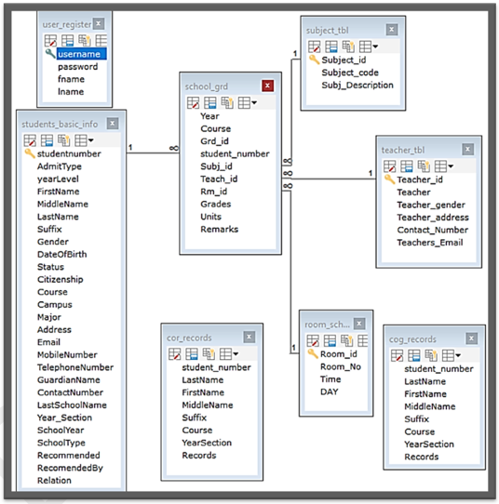
Data Schema Architecture

Slide 13
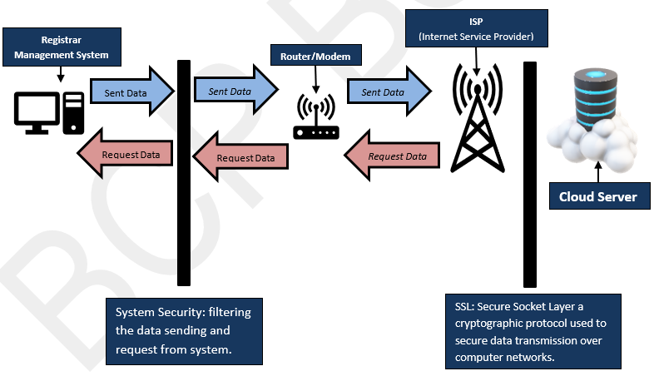
Technical Solution Design

Slide 14
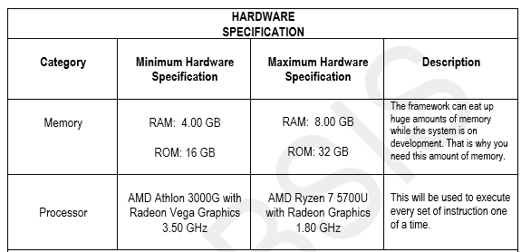
Technology Architecture

Slide 15
